Slide 1
Bargain Baubles
Andrea Clare Mohammad Sherwani

Slide 2
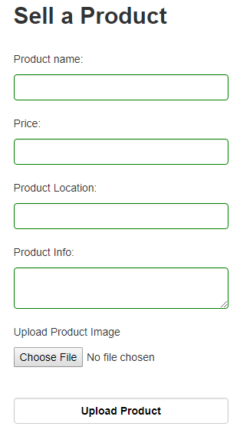
Create
For create we made a Sell Product system.
This system lets a user upload/advertise a product
Once submitted everything goes into the Database
Our systems lets you upload an image from anywhere on your computer

Slide 3
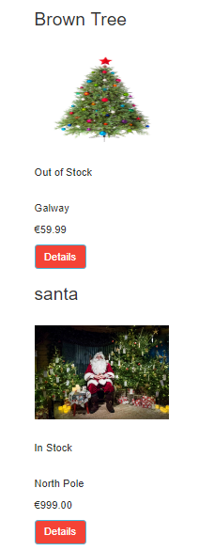
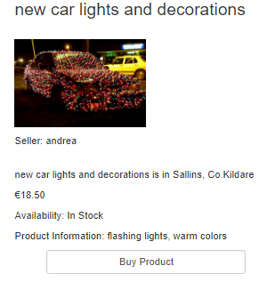
Read
The site picks up the products that where uploaded and displays them on the Products page
The Products details page is separate pages that displays each product individually

Slide 4



Update
We have two examples of Update:
When an item goes out of stock &&
When a user buys an item and their funds decrease

Slide 5
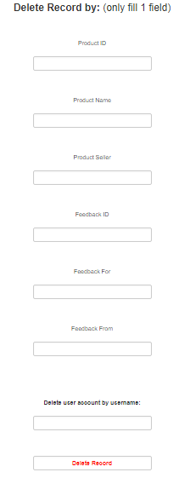
Delete
Our delete feature can only be used by the admin:
It lets the admin delete anything from a single product from its ID to an entire users account.

Slide 6
Validation
Validation on the upload form:
that redirects you to homepage each time you incorrectly complete a field
Small validator on the Add funds:
Makes sure the users card number is correct per user account

Slide 7
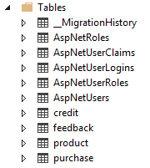
XML
Added four new tables
As we connected the tables successfully with Primary/Foreign Keys
Credit Table:
Feedback Table:
Product Table:
Purchase Table:

Slide 8
JQuery
Show
We have two show features, one that reveals content on the homepage and one that reveals the reviews, which is a slideToggle()
Hide
The hide feature we added hides reviews one by one
Fade
We have a gif that when its clicked it fades away and a button to bring it back

Slide 9
JQuery
Slideshow
Changes between pictures by JQuery
Animate
We have a feature that moves a gif across the screen, that can stop and revert back
Timeout
A one minute timer that gives you an alert
Back to Top button
When you scroll down this directs you to the top

